Slide 1
Control

Slide 2
Experimental

Slide 3
Control vs. Experimental
DD = 0.02

Slide 4
1st Week - Control vs. Experimental
Only 2% of variance

Slide 5
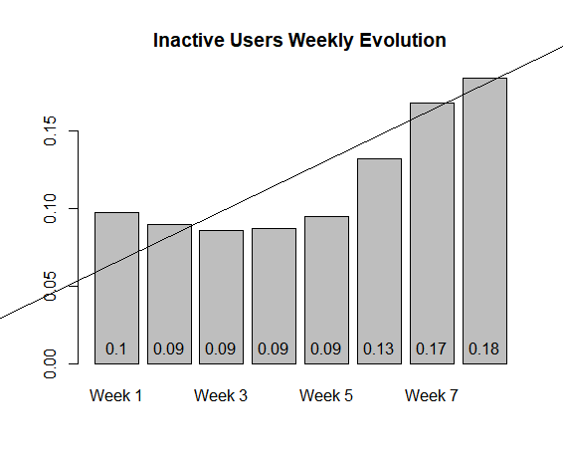

Slide 6
